Slide 1
Welcome to Javascript

Slide 2
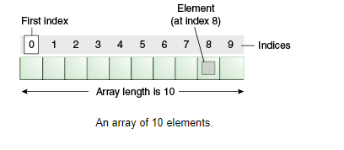
What is array

Slide 3
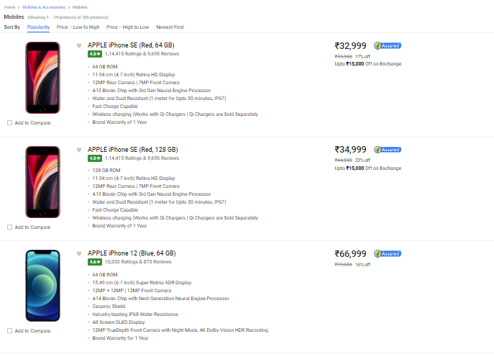
Real world problem- ecommerce

Slide 4

Real world problem - transport

Slide 5
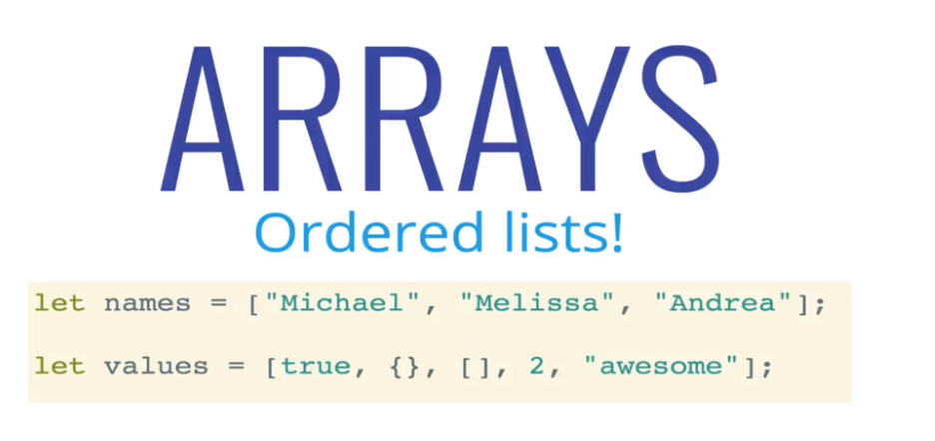
What is array

Slide 6
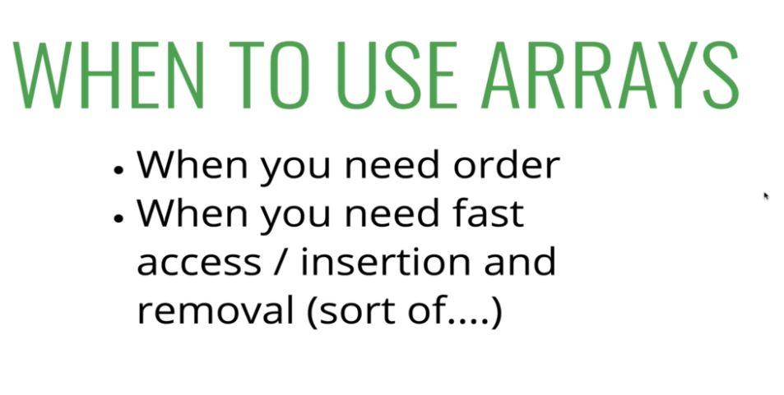
Array?

Slide 7
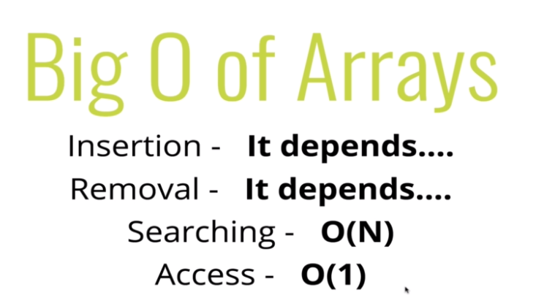
Space and time complexity

Slide 8
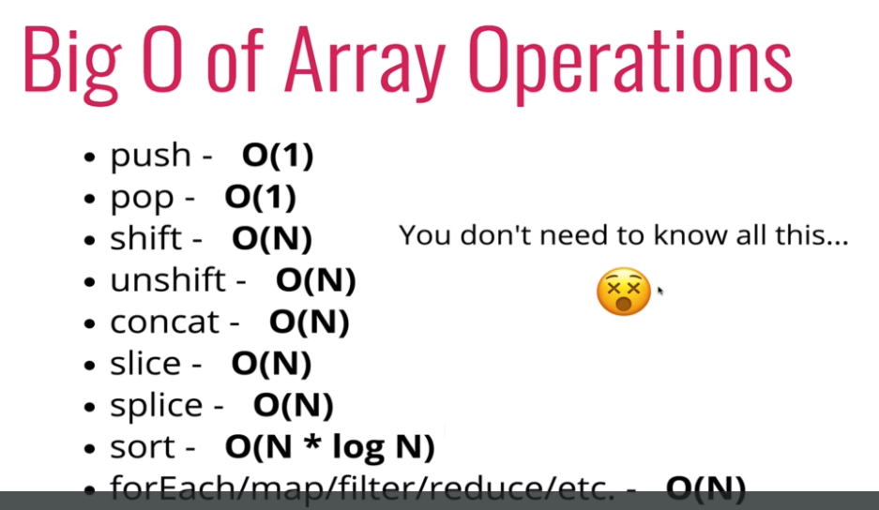
Built in function complexity

Slide 9
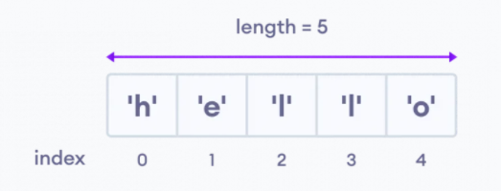
Array
An array is an object that can store multiple values, create an array is by using an array literal []
Create Array:
Access Elements of an Array:
Example:
// empty array
const myList = [ ];
// array of numbers
const numberArray = [ 2, 4, 6, 8];
// array of strings
const stringArray = [ 'eat', 'work', 'sleep'];
// array with mixed data types
const newData = ['work', 'exercise', 1, true];
Example:
const myArray = ['h', 'e', 'l', 'l', 'o'];
// first element
console.log(myArray[0]); // "h“
// second element
console.log(myArray[1]); // "e"

